Slide 1

energy conservation day
Presentation by
K ANANYA
RA2111032010011
CSE W/S IOT

Slide 2
OVERVIEW
14th of December is celebrated as the national energy conservation day by the people all over the India on. In the year of 2001, the Bureau of Energy Efficiency (BEE) executed the Energy Conservation Act in India. In this ppt let us take a walkthrough the significance of this particular day.

Slide 3
What do we mean by energy conservation?
The actual meaning of energy conservation is to avoid unnecessary use of energy and to use minimum energy so that energy sources can be saved for future uses. In order to make energy conservation plan more effective, every person should include energy conservation in their behaviors. That is how the national energy conservation day came into being. It is celebrated to sensitize people about the importance of energy as well as conserving or saving more energy by lesser wastage. Efficient use of energy is indispensable for storing energy for future use.

Slide 4
Continued…
Fossil fuels, Crude oil, Coal, natural gas and etc generate sufficient energy for the use in daily life but increasing the demands of it day by day creates the fear of reducing or diminishing the natural resources. The only way in replacing the non-renewable resources of energy with the renewable energy is energy conservation.
The government has come up with energy or carbon taxes in different countries to decrease the unnecessary wastage of energy. It is expected that imposing a tax on high energy consumption will reduce the energy use by the users as well as will promote limited energy use among users. Petroleum Conservation Research Association (established in 1977) and Bureau of Energy Efficiency (established in 2001) are the two major initiatives by the Government for better energy efficiency and conservation.

Slide 5
Different measures of energy consumption
Thermal curtains and Smart windows or films are major contributors to energy consumption.
Compact fluorescent lamp or CFL, Fluorescent bulbs, Linear fluorescent retrofit, Solar charged flashlight, Skylights, Smart windows, LED lighting and Solar lights are some of the techniques to save energy.
Water conservation also leads to the better energy conservation. 1.6 GPM or less low flow showerheads, Ultra low flush toilet, Faucet aerator, Composting toilets, etc are various means of water saving solutions.
Insulation also plays a big role in energy conservation by decreasing the thermal losses in winter seasons as well as thermal gains in summer seasons. For example; natural wool insulation, house insulation, cotton insulation, VOCs in fiber glass insulation, thermal insulation, cellulose insulation and etc.

Slide 6


Slide 7
A way of celebrating National Energy Conservation Day
To publicize and promote the particular day, a variety of energy conservation competitions or painting competitions are organized by the government or other organizations around the living areas of normal people as they are the main target of the campaign. These events are held at state or national level. Every participant will get a theme Topic such as the “Today’s energy wastage is tomorrow’s energy shortage”, “More stars, more savings”, “Energy saved is future save” and many more. Participants can make their painting more effective by using the Pencil Color, Crayons, Water Color and etc.
Apart from painting competition, debates, conferences, workshops, discussions and many of the competitions organized by the Government in every State of the Country on this significant day.

Slide 8

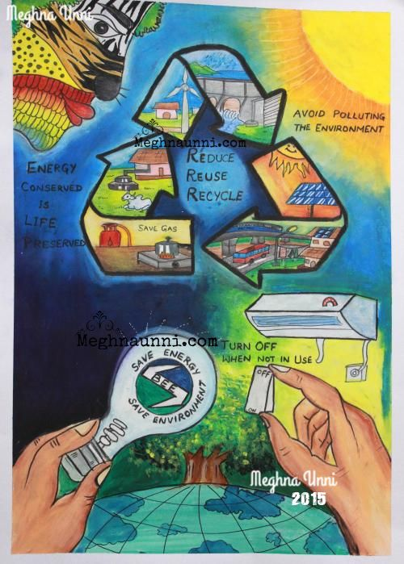
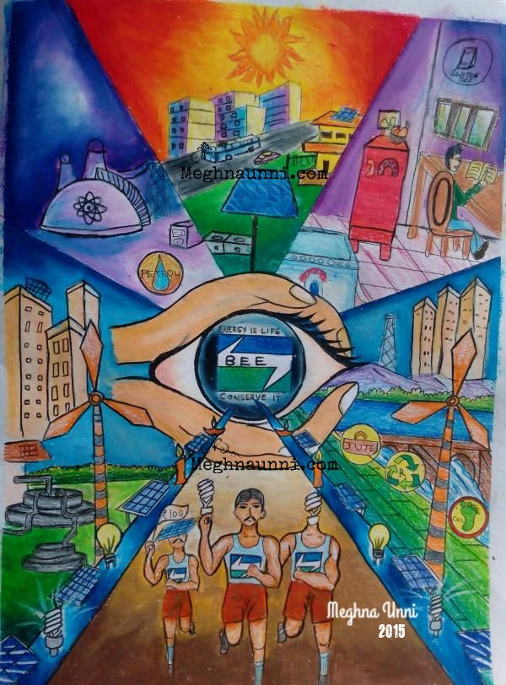




Slide 9
Role of Indian citizens in conserving energy
It is essential for each and every citizen of India to be aware of how to use efficient energy, how to save the energy for their own future safety and many more ways. In order to support the energy efficiency, the Government of India has implemented certain rules, regulations and policies which need to be followed by the citizens of India. They can pay their direct contribution to the campaign to reduce energy use throughout the 11th Five Year Plan period. Children are one of the big expectations and hope for the country to bring positive changes as well as to improve the economic being of the country.

Slide 10
Importance of National Energy Conservation Day
National Energy Conservation Day solely aims to make the country aware of the effects and its causes of the Energy which is used by every people in the World. It implies the importance and sustainability of natural resources.
It is very crucial and essential for every people around the world to follow the National Energy Conservation Day. National Energy Conservation Day solely aims to make the country aware of the effects and its causes of the Energy which is used by every people in the World. It implies the importance and sustainability of natural resources.
Formal education on the importance of energy is very important for every people and mostly for the young generations who are the future of the country and can make every people carry out many of the developmental tasks for the betterment of the people.

Slide 11
CONTINUED….
Students should be able to get the knowledge about how to save the energy and how to concentrate on saving much of the energy. It is very useful to focus on the Welfare of the people by developing all the activities. This helps in overall development of the younger generation. However, parents should also actively participate in educating their child for saving the natural energy and to reduce the energy consumption by possible ways.
Lastly, there are many of the rules and regulations laid down by the Government to make every people in every Country to focus on conserving the National Energy.

Slide 12


